Slide 1
New Indian restaurant in San Francisco Bay Area
By Vishnu Priya

Slide 2
Goal
Analytic Approach
Data collection and preparation
Methodology- K-Means Cluster
Evaluation
Conclusion

Slide 3
Goal
Recommend the suitable location to open Indian restaurant in Bay area neighborhood.
The targeted audiences
people looking to open a new Indian restaurant
people looking to expand their business
Analytic approach
Collect the San Francisco bay area neighborhood data and find its geolocation information.
Using Foursquare API, nearby venues for each neighborhood are collected.
Visualize the Data in map using folium library.
Calculate the mean of all venue groups and clustering neighborhoods using K-means modeling.
Examine Clusters to find the suitable neighborhood to start an Indian Restaurant.

Slide 4
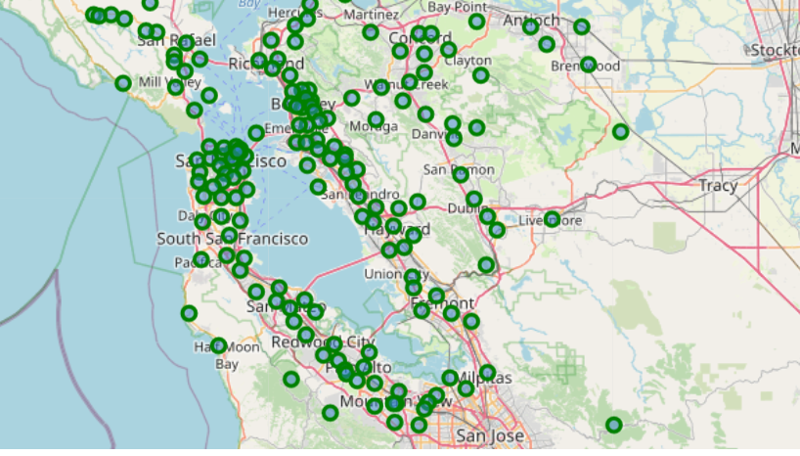
Data collection and preparation
Download the bay area neighborhood data from
https://data.sfgov.org/api/views/f9wk-m4qb/rows.csv?accessType=DOWNLOAD
Using pgeocode latitude and longitude are derived.
Using foursquare API, 100 venues are gathered for each zipcode’s geolocation, within the radius of 3000 meters.
There are 358 unique venue categories from this data set, across 87 bay area neighborhoods.
Total number of Indian restaurants in neighborhood : 40

Slide 5
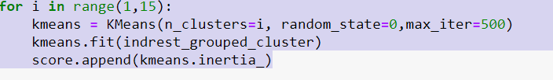
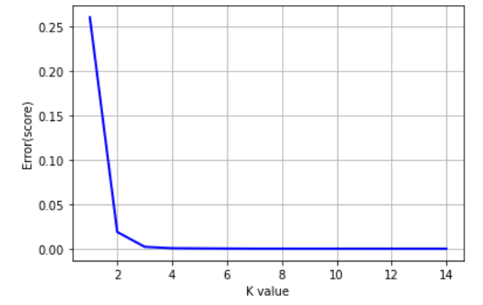
K-Means Cluster
Define the clusters and find the best place for opening the Indian restaurant
To find the best K value
The best value for k is 3 based on this graph using elbow method.

Slide 6
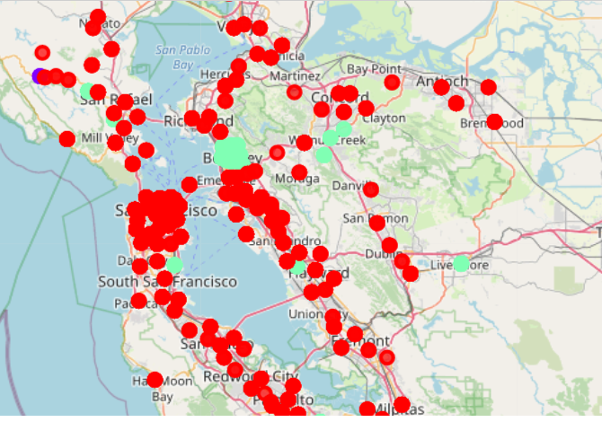
Evaluation
Each clusters are evaluated by calculating it’s total and average Indian restaurants
Cluster | No. of Neighborhoods | No. of Indian restaurants | Average
0 | 76 | 15 | 0.197
1 | 1 | 2 | 2
2 | 10 | 23 | 2.3

Slide 7
Conclusion
Cluster 0 has the least average Indian restaurant and hence it is the best neighborhood to open an Indian restaurant.
This analysis considered only the foursquare data for top 100 venues only.
Although to open a restaurant, we need to consider the real estate cost, crime rate etc., these were not considered in the scope of this project.

